Slide 1



Data Modelling - IS411 CL-HY
Group 2
Early Stroke Prediction Model Using eXtreme Gradient Boosting (XGB) Classification Algorithm

Slide 2






Group 2
Christopher Darren
Emillio Hezekiah L
Obie Krisnanto
Ray Theodorus
Rendy Wirawan Tamrin
Vincencius Christiano Tjokro
00000054804
00000054742
00000054153
00000054779
00000053580
00000053887
000000

Slide 3


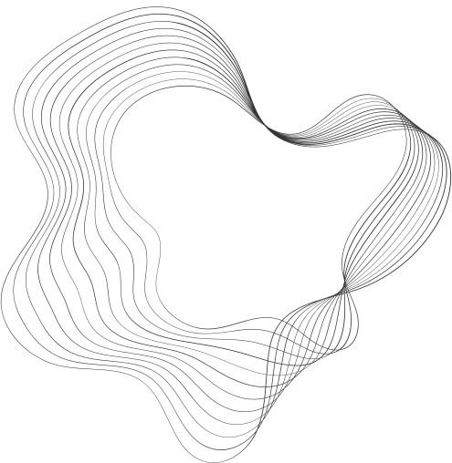
CONTENT
01
ABSTRACT
02
INTRODUCTION
03
LITERATURE STUDY
04
METHODOLOGY
05
RESULT & ANALYSIS
06
CONCLUSION
07
REFERENCES

Slide 4




ABSTRACT

Slide 5
Stroke has been the leading cause of death worldwide over the decade due to the failure to detect the risk of stroke in earlier phases. This problem could be solved with the help of a machine learning classification model. Comparison among model performance shows that eXtreme Gradient Boosting (XGBoost) algorithms with a hyper-parameter of {'learning_rate': 0.2, 'max_depth': 5, 'n_estimators': 300} has the best ability to distinguish between patient with or no stroke with an accuracy score of 95.64% and Area Under Curve (AUC) of 0.956 compared to K-Nearest Neighbor (KNN), Support Vector Machine (SVM), and Decision Tree.

Slide 6

INTRODUCTION

Slide 7
Stroke cases have surged by 70% in recent decades, making it the third leading cause of death worldwide. In 2019, 6.6 million people died from stroke, and 143 million survivors faced disability. Low and middle-income countries are at higher risk due to limited resources and decreased productivity. Early detection is crucial, and machine learning algorithms offer a promising solution. By developing accurate prediction models, researchers aim to revolutionize stroke prevention and reduce its impact on individuals and society.

Slide 8

LITERATURE
STUDY

Slide 9
Similar studies conducted in 2022 have focused on stroke prediction using the K-Nearest Neighbour (KNN) and eXtreme Gradient Boosting (XGBoost) algorithms. The KNN model achieved an accuracy of 95% by utilizing data from the World Stroke Organization. On the other hand, the XGBoost algorithm yielded an accuracy of 96%.
References:
P. S. Kohli and S. Arora, (2018). Application of Machine Learning in Disease Prediction. 4th International Conference on Computing Communication and Automation (ICCCA), 1-4, 10.1109/CCAA.2018.8777449.
A. M. Rahim, A. Sunyoto, and M. R. Arief, “Stroke prediction using machine learning method with extreme gradient boosting algorithm,” MATRIK : Jurnal Manajemen, Teknik Informatika dan Rekayasa Komputer, vol. 21, no. 3, pp. 595–606, 2022. doi:10.30812/matrik.v21i3.1666

Slide 10
Theory
Extreme Gradient Boosting
K-Nearest Neighbour
Support Vector Machines
Decision Tree

Slide 11

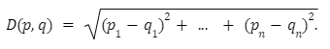
K-Nearest Neighbour (KNN) is an instance-based learning classification algorithm. In KNN, there are two key concepts for classification: Euclidean distance and K-Number. Euclidean distance is calculated using the following formula:
Here, p and q represent the subjects being compared, with n representing the number of characteristics. K-Number refers to the number of nearest neighbors considered for a specific query point. Determining an optimal K-value is crucial to avoid overfitting, and it can be obtained by taking the square root of the number of observations.
K-Nearest Neighbour

Slide 12
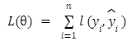

XGBoost is an ensemble learning method based on Decision Trees. It iteratively adjusts model parameters to minimize training loss, and the training loss is calculated using the following formula:
Here, L represents the loss function, represents the regularization function, and represents the model parameters. The loss function is calculated with:
Where y represents the true value, y is the prediction score of the model, and n is the number of iterations.
Extreme Gradient Boosting
i
i

Slide 13
Support Vector Machines (SVM) is a powerful supervised machine learning algorithm used for classification and regression tasks. It provides optimized and expected solutions but has certain limitations, such as handling large datasets, multi-class classification, and imbalanced datasets
Support Vector Machines

Slide 14
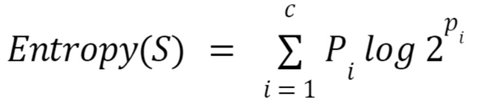
Decision trees are supervised machine learning algorithms that sequentially split data to determine binary outcomes at leaf nodes. Decision making in decision trees is based on two important concepts: entropy and information gain. Entropy measures data uncertainty and can be calculated using the formula:
Information gain calculates the difference in entropy after data segmentation and can be calculated using the formula:
S represents the dataset, A represents the attribute, |Sv| represents the number of instances in subset Sv, and |S| represents the number of instances in dataset S. Higher information gain indicates that the data is more likely to be segmented or classified accurately among classes.
Decision Tree

Slide 15
METHODOLOGY

Slide 16
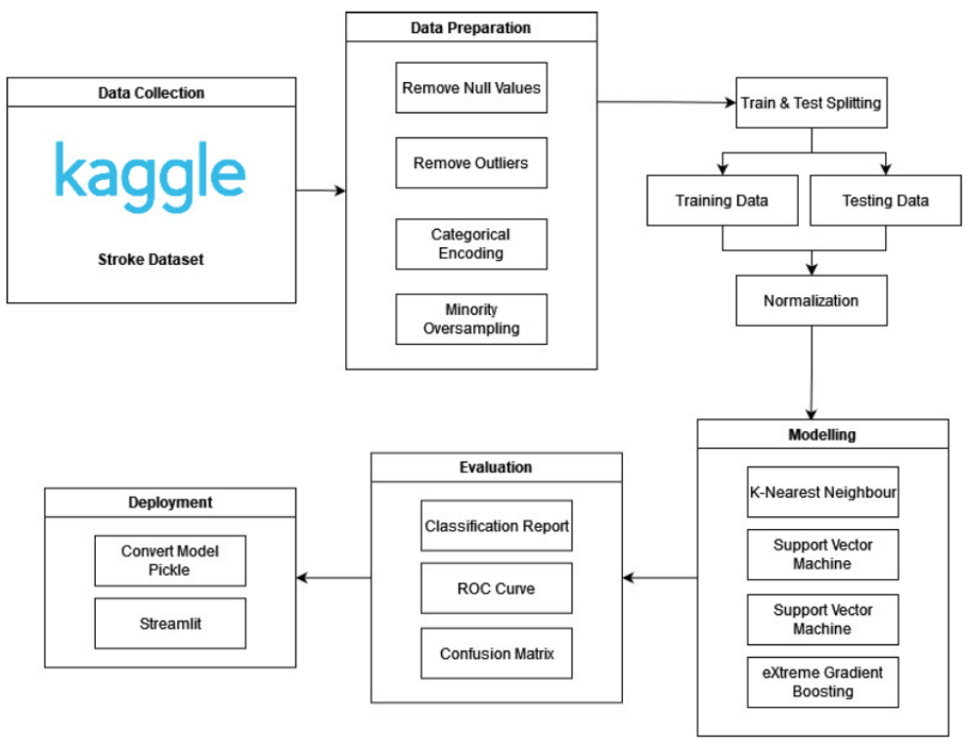
CRISP-DM Methodology
This is the research flowchart based on CRISP-DM.

Slide 17
BUSINESS UNDERSTANDING

Slide 18
Tujuan utama dari model prediksi ini adalah untuk mengidentifikasi risiko dengan menggunakan beberapa model prediksi untuk memahami apakah seseorang berisiko tinggi mengalami stroke di masa depan. Hal ini membantu dalam mengambil tindakan pencegahan yang tepat untuk mengurangi dampak stroke yang mungkin terjadi.

Slide 19
DATA UNDERSTANDING
Exploratory Data Analysis

Slide 20
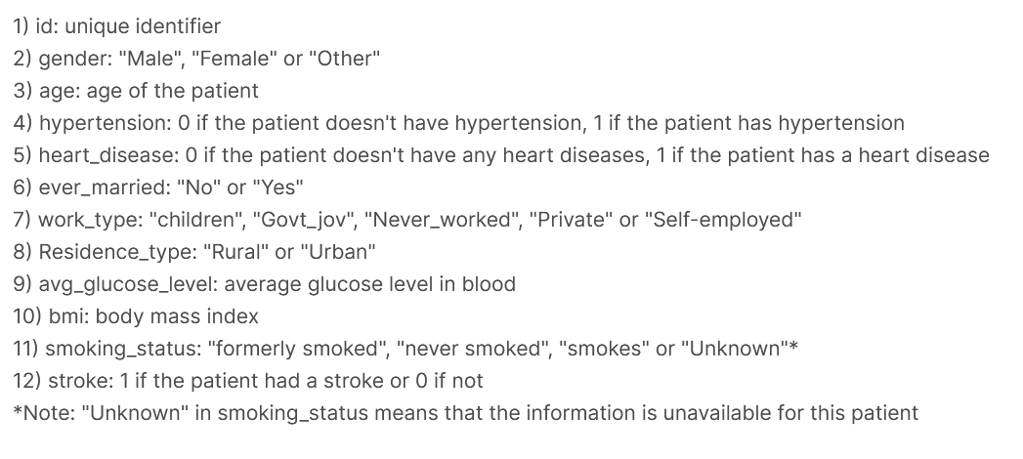
DATASET
Source: kaggle.com/datasets/fedesoriano/stroke-prediction-dataset

Slide 21
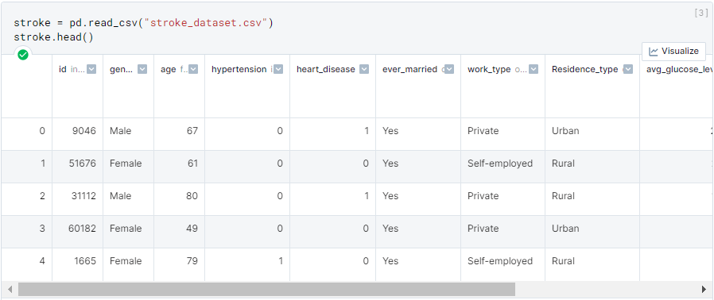
IMPORT DATA

Slide 22
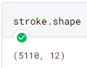
SHAPE OF DATA

Slide 23
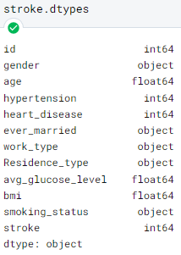
DATA TYPE

Slide 24
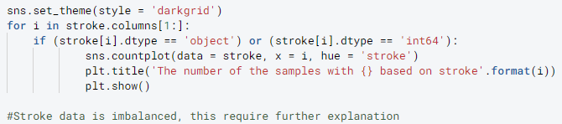
EXPLORATORY DATA ANALYSIS
Function to create countplot that shows the number of samples with every Features based on Stroke

Slide 25
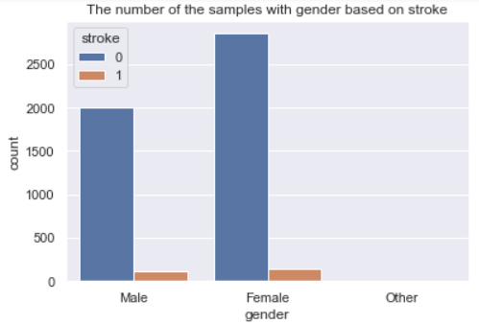
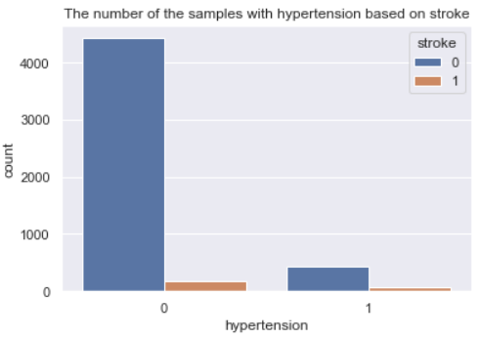
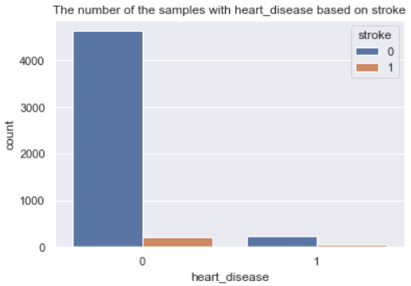
EXPLORATORY DATA ANALYSIS
The number of the samples with gender, hypertension, and heart_disease based on stroke

Slide 26
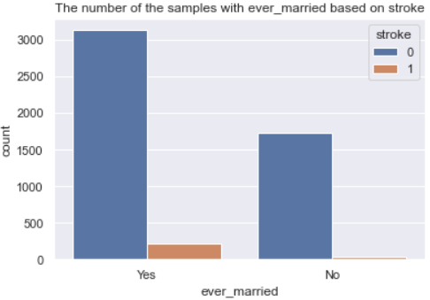
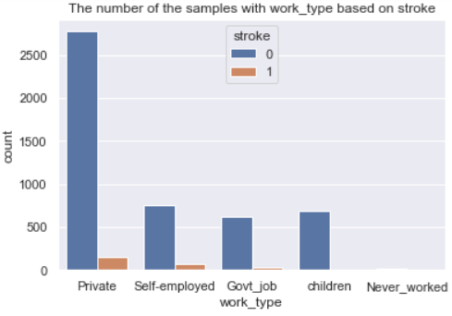
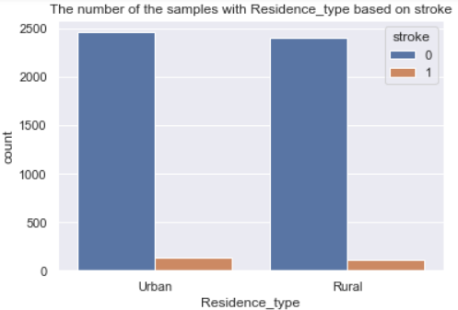
EXPLORATORY DATA ANALYSIS
The number of the samples with ever_married, work_type, and residence_type based on stroke

Slide 27
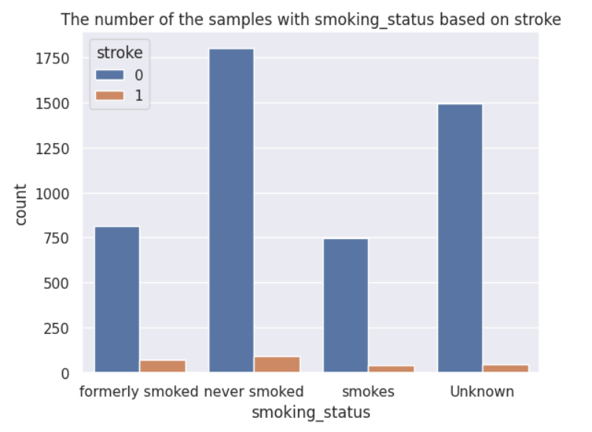
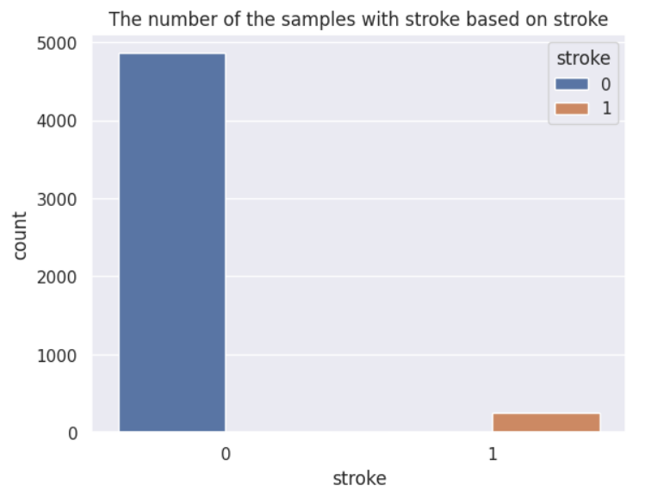
EXPLORATORY DATA ANALYSIS
The number of the samples with smoking_status and stroke

Slide 28
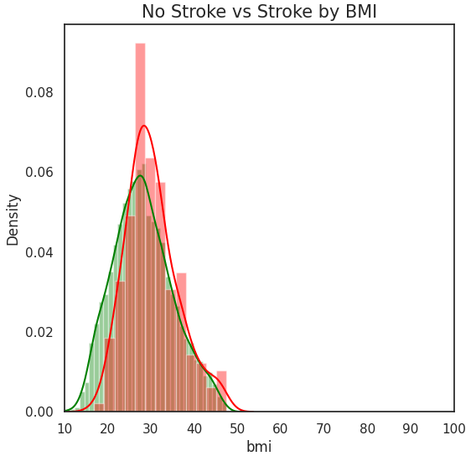
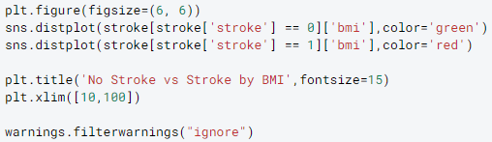
EXPLORATORY DATA ANALYSIS
Create distplot that shows the skewness of stroke and non-stroke patients by BMI

Slide 29
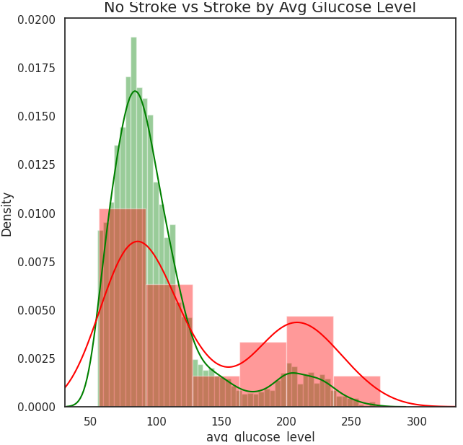
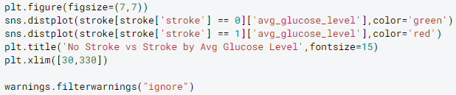
EXPLORATORY DATA ANALYSIS
Create distplot that shows the skewness of stroke and non-stroke patients by Glucose Level

Slide 30
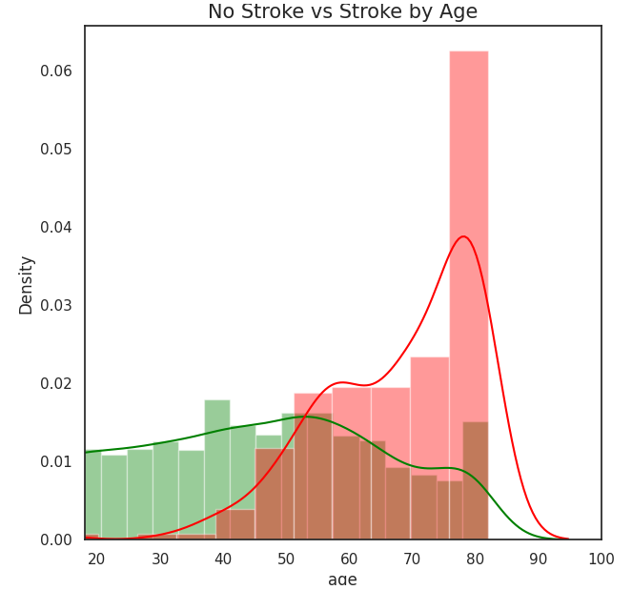
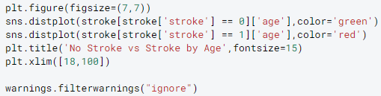
EXPLORATORY DATA ANALYSIS
Create distplot that shows the skewness of stroke and non-stroke patients by Age

Slide 31
DATA PREPARATION
Data cleaning, outliers removal, splitting, normalization, and oversampling.

Slide 32
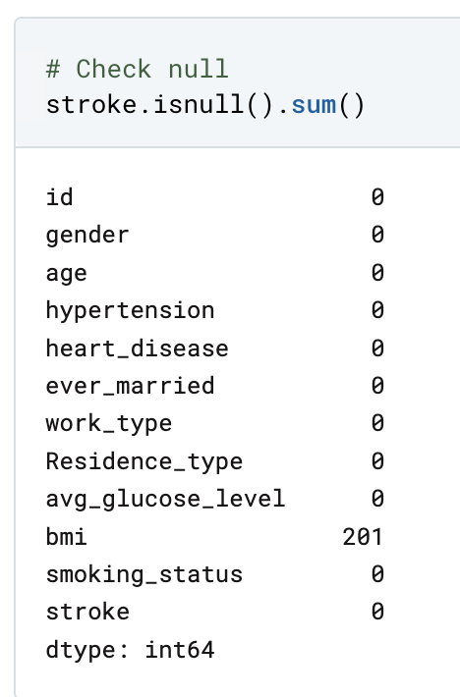
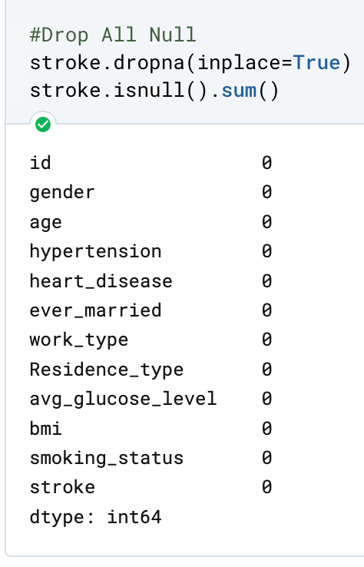
REMOVE NULL
Remove all NaN Values
Before
After

Slide 33
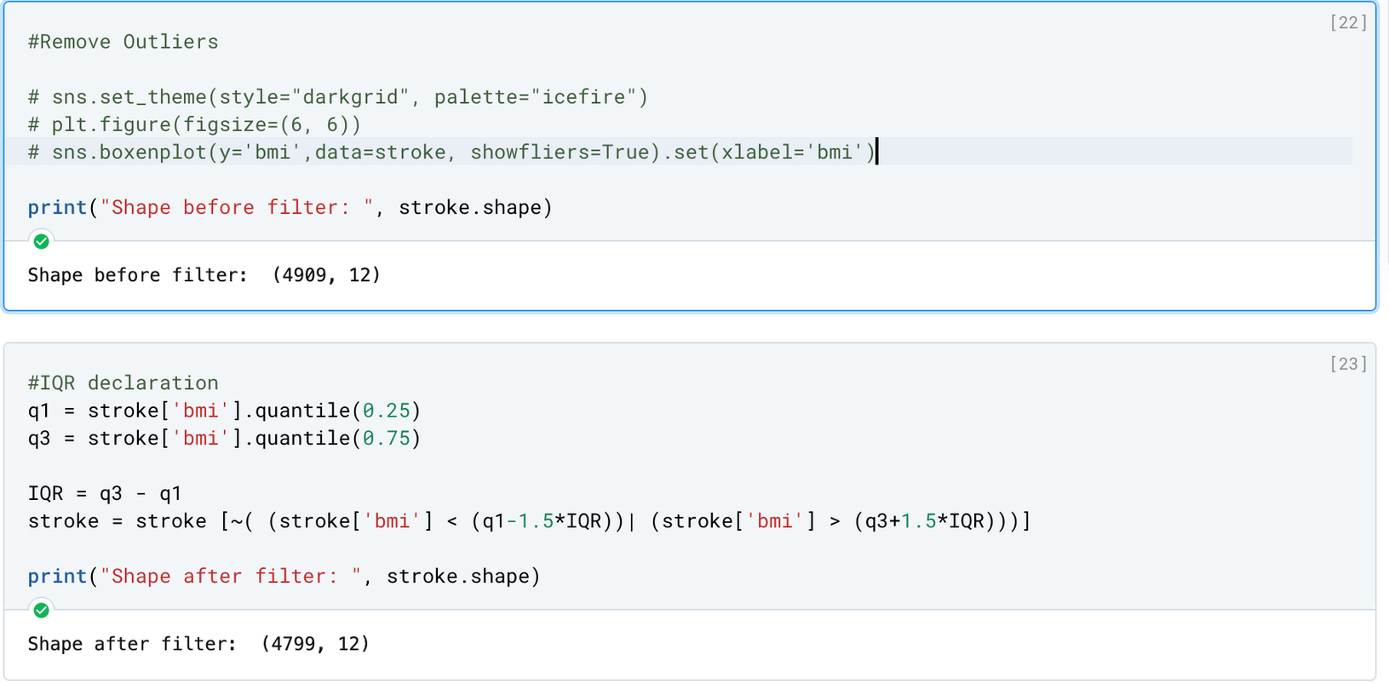
REMOVE OUTLIERS
With IQR Method
Before
After

Slide 34
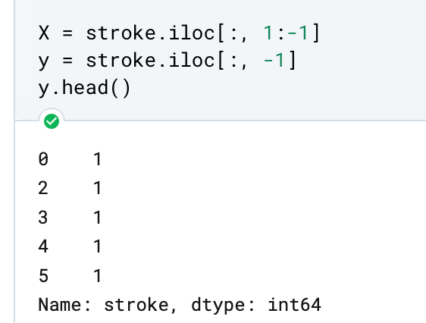
SPLIT X & Y
Splitting Features and Target Variable

Slide 35
SPLIT X & Y
Splitting Features and Target Variable

Slide 36
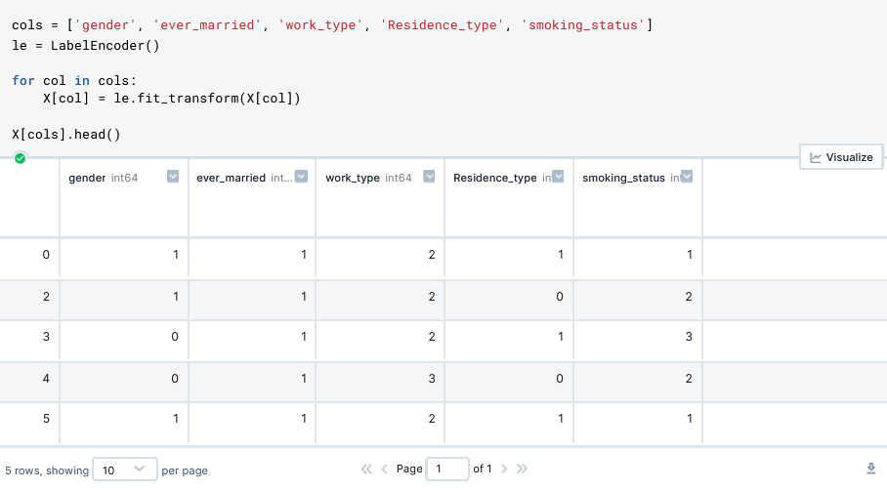
ENCODE CATEGORICAL
Encode categorical data with LabelEncoder

Slide 37
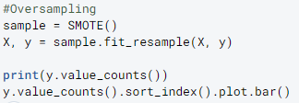
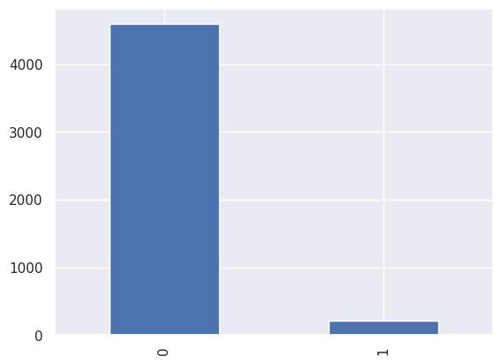
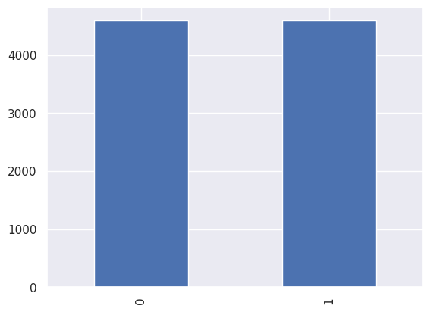
OVERSAMPLING
Oversampling minority data with SMOTE
Before
After

Slide 38
SPLIT TRAIN TEST
Split data to train and test
Ratio 80:20

Slide 39
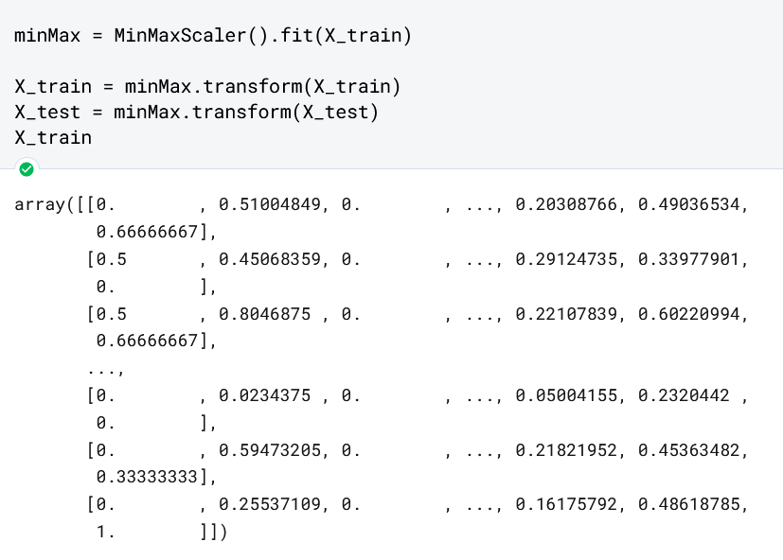
NORMALIZE DATA
Normalize data with MinMaxScaler

Slide 40

MODELLING
In this study there are 4 machine learning algorithms which will be implemented to make an early stroke classification model consisting of K-Nearest Neighbor (KNN), Support Vector Machine (SVM), Decision Tree, and eXtreme Gradient Boosting (XGBoost).

Slide 41
EVALUATION
For evaluation and comparison purposes,several evaluation techniques which will be implemented consist of confusion matrix, accuracy score, recall score, F1 score, and ROC Curve.

Slide 42


RESULT & ANALYSIS

Slide 43
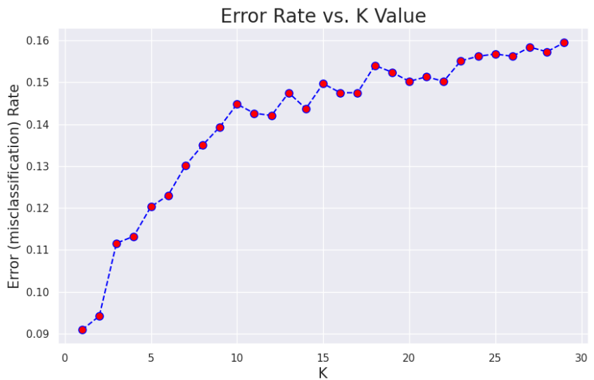
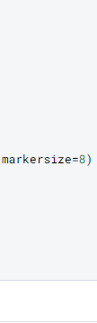
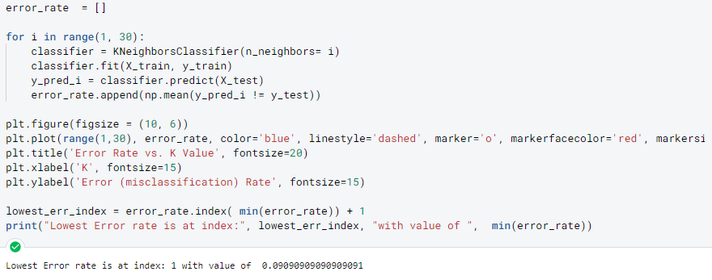
K-NEAREST NEIGHBOUR
Finding Lowest Error rate

Slide 44
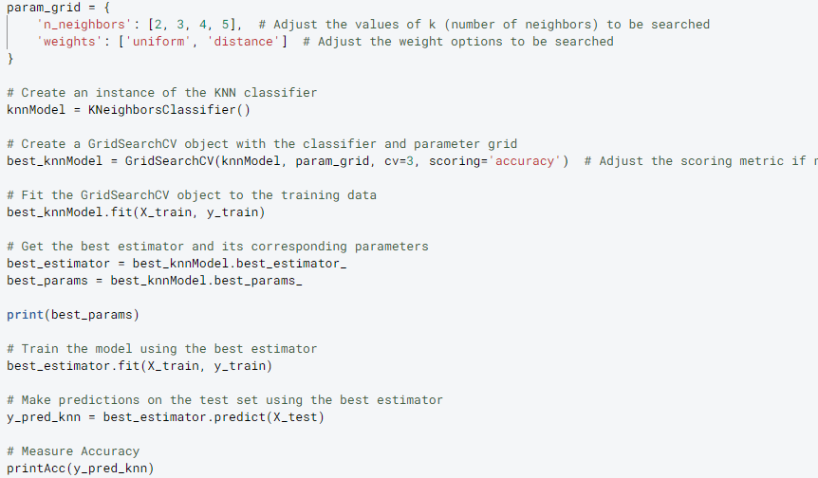
K-NEAREST NEIGHBOUR
Model Creation

Slide 45
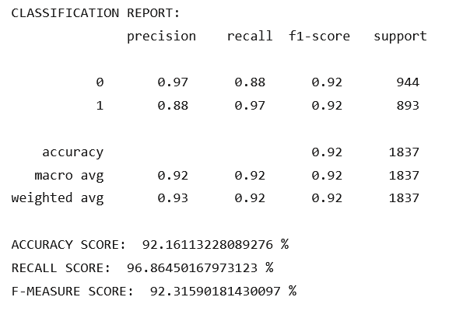
Classification Report of
K-Nearest Neighbour Model
With Best Parameters:
{'n_neighbors': 2, 'weights': 'distance'}

Slide 46
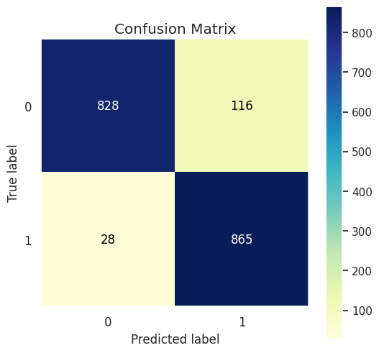
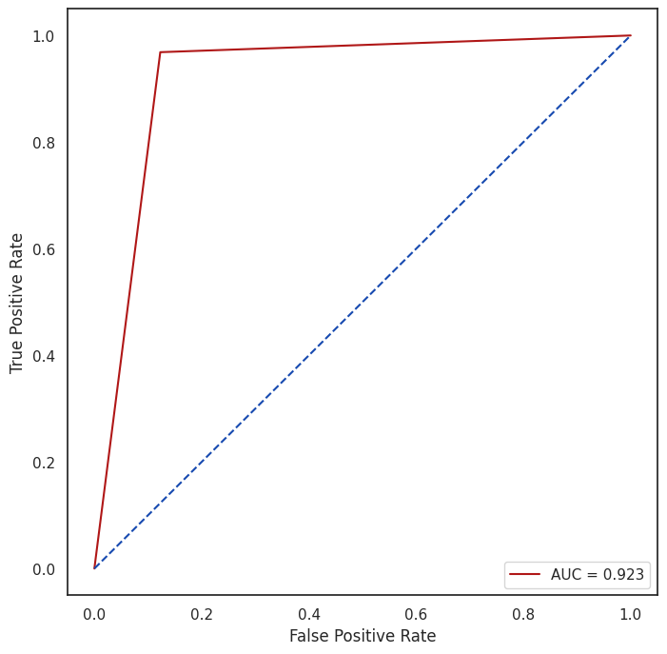
K-NEAREST NEIGHBOUR
Evaluation

Slide 47
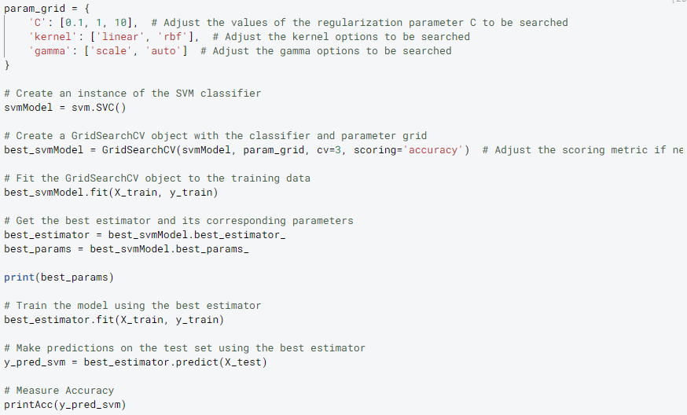
SUPPORT VECTOR MACHINE
Model Creation

Slide 48
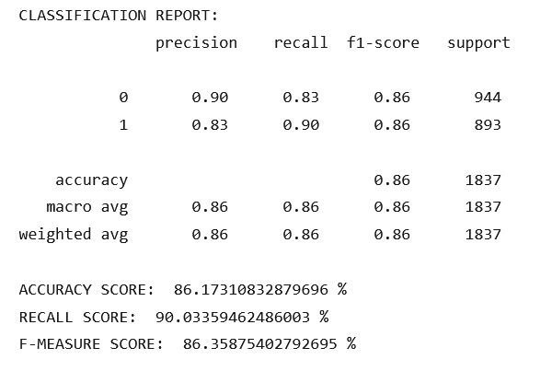
Classification Report of
Support Vector Machine Model
With Best Parameters:
{'C': 10, 'gamma': 'scale', 'kernel': 'rbf'}

Slide 49
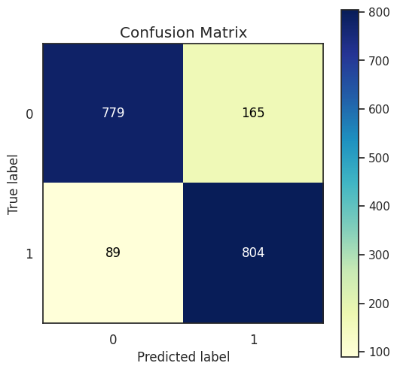
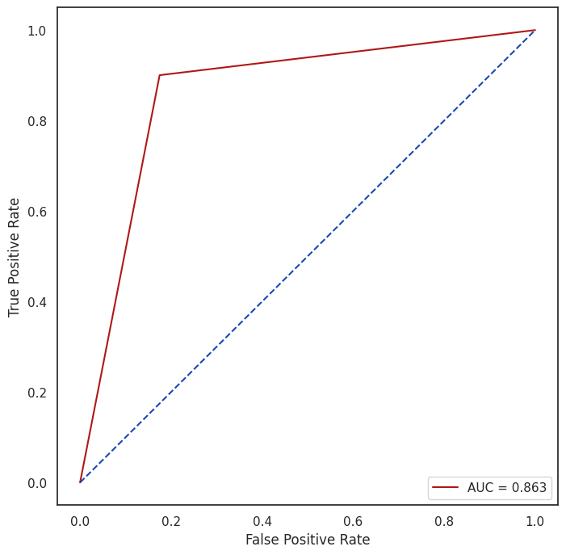
SUPPORT VECTOR MACHINE
Evaluation

Slide 50
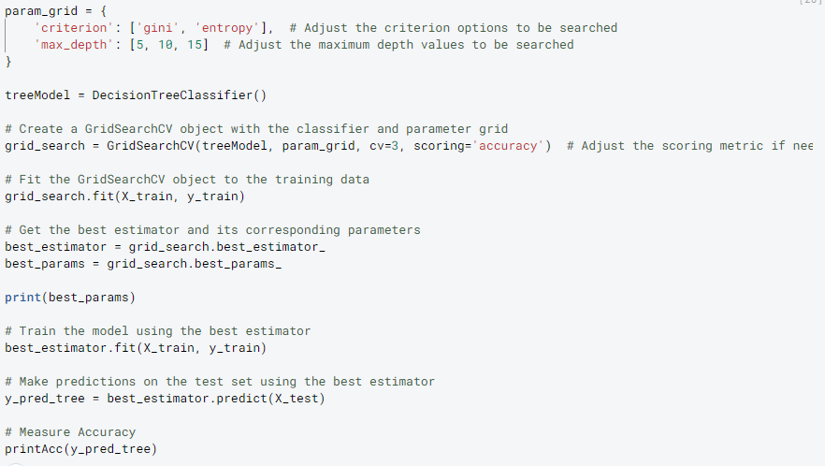
DECISION TREE
Model Creation

Slide 51
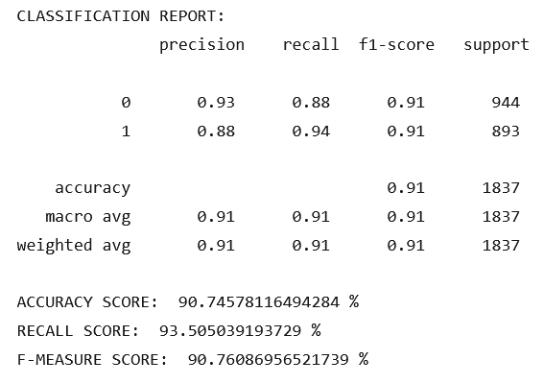
Classification Report of
Decision Tree Model
With Best Parameters:
{'criterion': 'entropy', 'max_depth': 15}

Slide 52
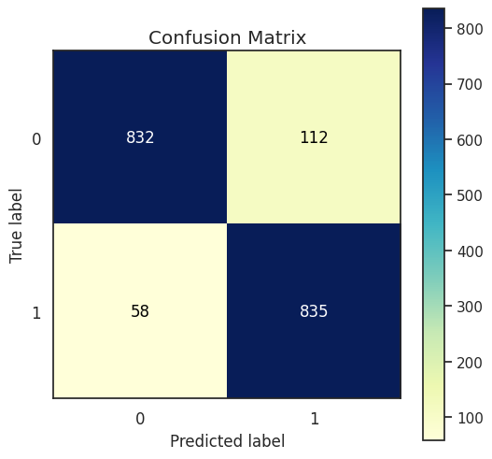

DECISION TREE
Evaluation

Slide 53
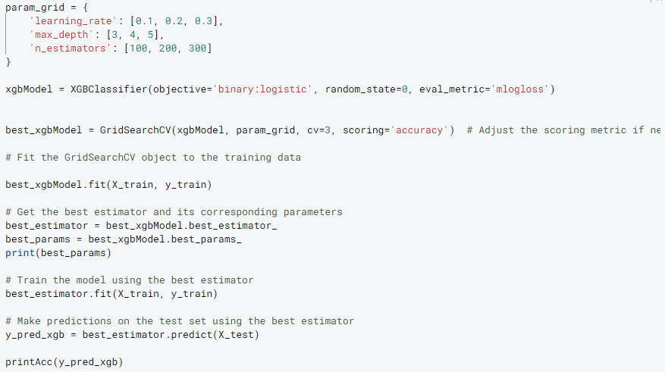
EXTREME GRADIENT BOOSTING
Model Creation

Slide 54
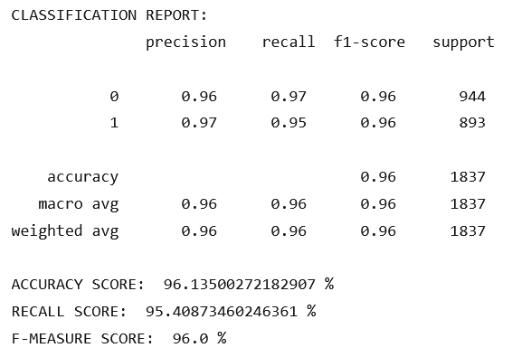
Classification Report of
xGBoost Model
With Best Parameters:
{'learning_rate': 0.3, 'max_depth': 5, 'n_estimators': 300}

Slide 55
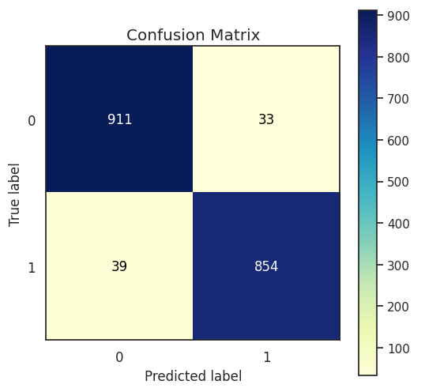

XGBOOST
Evaluation

Slide 56

PERBANDINGAN ALGORITMA
Visualisasi

Slide 57

DEPLOYMENT

Slide 58


DEPLOYMENT

Slide 59
xGBoost is an algorithm with the highest accuracy of 96.8%, while the highest recall score is achieved by KNN with 96.8%. On the other hand, SVM produces the lowest overall score.
CONCLUSION

Slide 60
REFERENCES

Slide 61
Owolabi, M. O., Thrift, A. G., & Mahal, A. (2022). Primary stroke prevention worldwide: translating evidence into action. The Lancet Public Health, 7(1), e74-e85. https://doi.org/10.1016/S2468-2667(21)00230-9
Maskuri, M. N., Sukerti, K., & Bhakti, H. (2022, Mei). Penerapan Algoritma K-Nearest Neighbor (KNN) untuk Memprediksi Penyakit Stroke. Jurnal Ilmiah Intech : Information Technology Journal Of UMUS, 4(1), 130-140. http://jurnal.umus.ac.id/index.php/intech/article/view/751/452
P. S. Kohli and S. Arora, (2018). Application of Machine Learning in Disease Prediction. 4th International Conference on Computing Communication and Automation (ICCCA), 1-4, 10.1109/CCAA.2018.8777449.
A. M. Rahim, A. Sunyoto, and M. R. Arief, “Stroke prediction using machine learning method with extreme gradient boosting algorithm,” MATRIK : Jurnal Manajemen, Teknik Informatika dan Rekayasa Komputer, vol. 21, no. 3, pp. 595–606, 2022. doi:10.30812/matrik.v21i3.1666
Chen, T., & He, T. (2017, January 4). xgboost: eXtreme Gradient Boosting [Package Version: 0.6-4]. https://cran.r-project.org/web/packages/xgboost/vignettes/xgboost.pdf
S. E. Herni Yulianti, Oni Soesanto, and Yuana Sukmawaty, “Penerapan metode extreme gradient boosting (XGBOOST) pada klasifikasi Nasabah Kartu Kredit,” Journal of Mathematics Theory and Application, vol. 4, no. 1, pp. 21–26, 2022. doi:10.31605/jomta.v4i1.1792
Jijo, B. T., & Abdulazeez, A. M. (2021). Classification Based on Decision Tree Algorithm for Machine Learning. Journal of Applied Science and Technology Trends, 2(1), 20 - 28. https://www.researchgate.net/profile/Purvi-Prajapati/publication/330138092_Study_and_Analysis_of_Decision_Tree_Based_Classification_Algorithms/links/5d2c4a91458515c11c3166b3/Study-and-Analysis-of-Decision-Tree-Based-Classification-Algorithms.pdf
Z. Zhang, “Introduction to machine learning: K-Nearest Neighbors,” Annals of Translational Medicine, vol. 4, no. 11, pp. 218–218, 2016. doi:10.21037/atm.2016.03.37
“Cross-industry standard process for data mining (CRISP-DM),” MMSI BINUS University, https://mmsi.binus.ac.id/2020/09/18/cross-industry-standard-process-for-data-mining-crisp-dm/ (accessed Jun. 10, 2023).
Fedesoriano, (2020). Stroke Prediction Dataset. https://www.kaggle.com/datasets/fedesoriano/stroke-prediction-dataset.
A. Agrawal, “Python pickling: What it is and how to use it securely: Synopsys,” Application Security Blog, https://www.synopsys.com/blogs/software-security/python-pickling/#:~:text=Pickle%20in%20Python%20is%20primarily,transport%20data%20over%20the%20network. (accessed Jun. 14, 2023).
N. Mhadhbi, “Python tutorial: Streamlit,” DataCamp, https://www.datacamp.com/tutorial/streamlit (accessed Jun. 14, 2023).

Slide 62
THANK YOU

